Slide 1
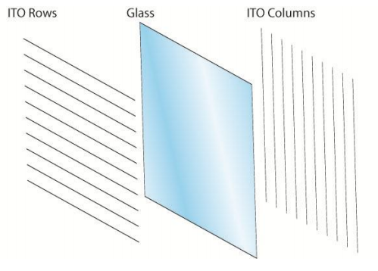
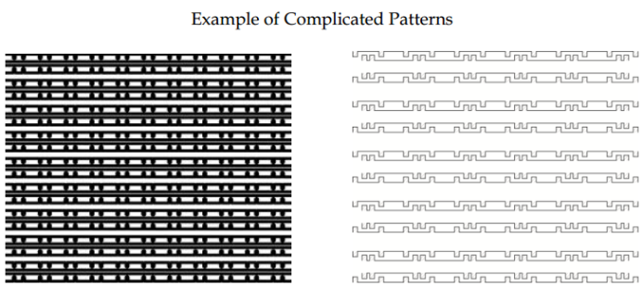
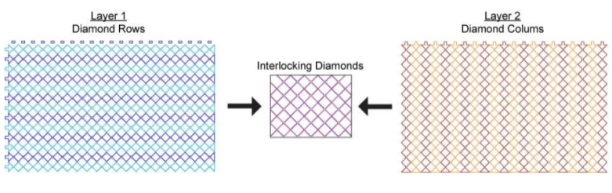
a) b) c)

Slide 2
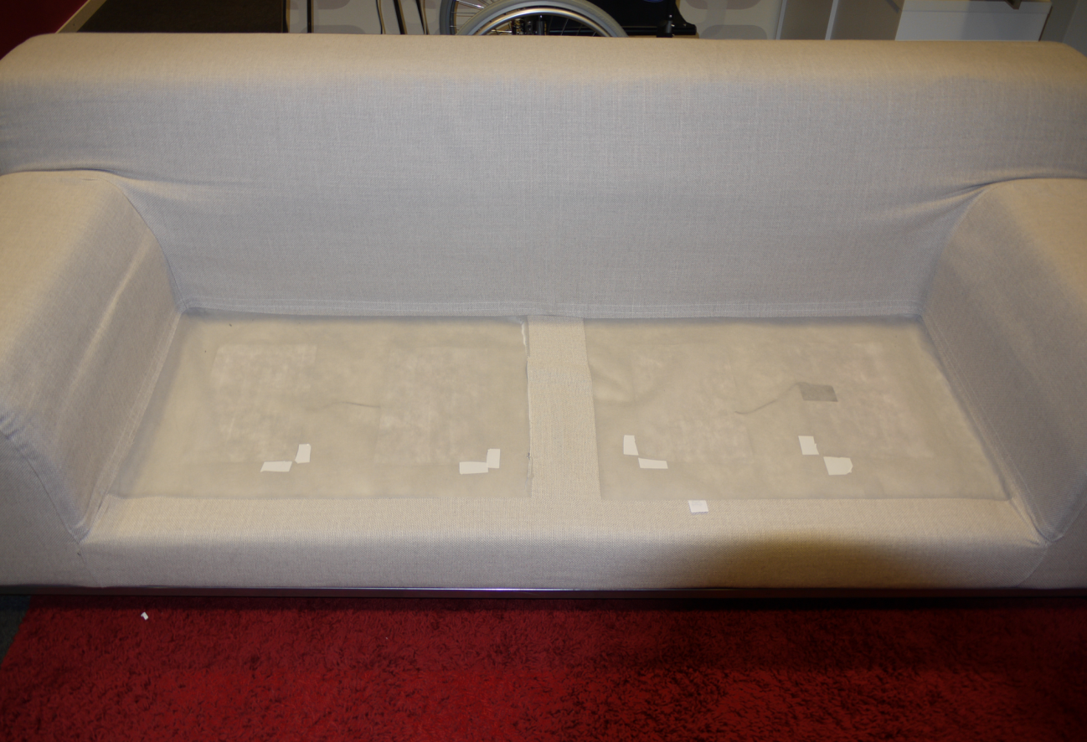

Slide 3
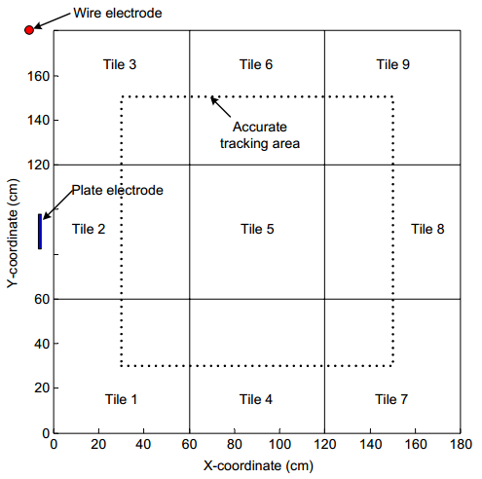

Slide 4
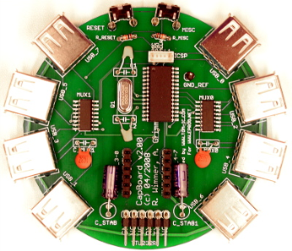
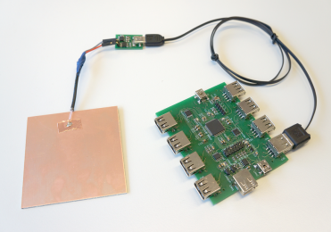

Slide 5
Analog signal
Raw data
processing
High-level
processing
A/D conversion

Slide 6
Raw Value
Baseline
Baseline Reset Threshold
Value
Time

Slide 7
if object found
Set uniform probability
Update probability
Fit object
Tracking methods
if object not found

Slide 8
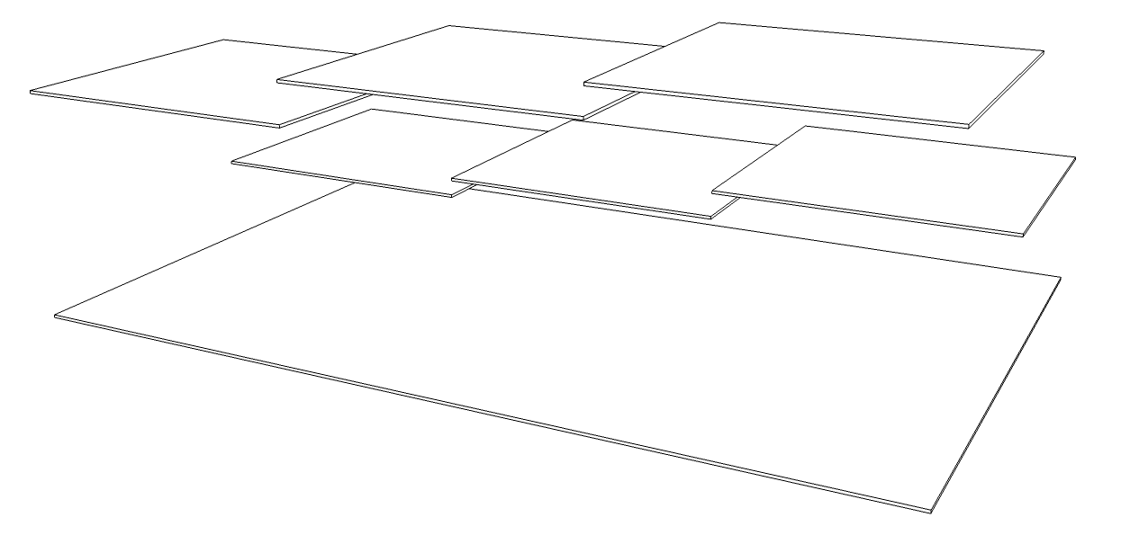

Slide 9
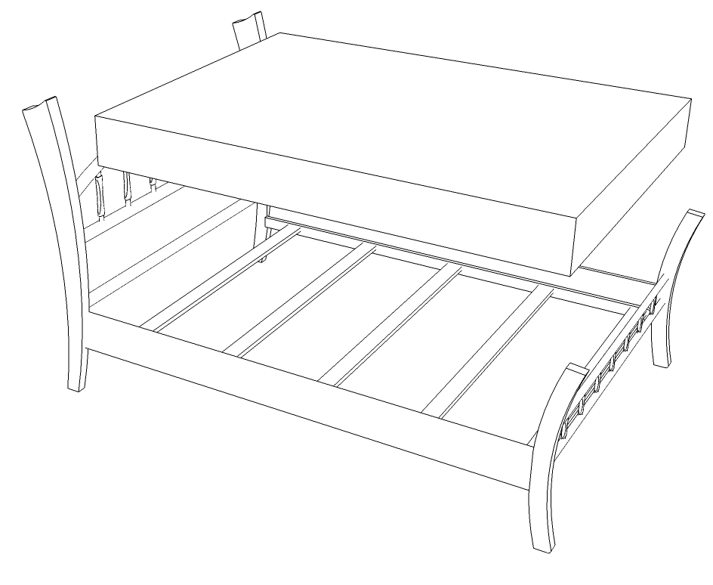

Slide 10
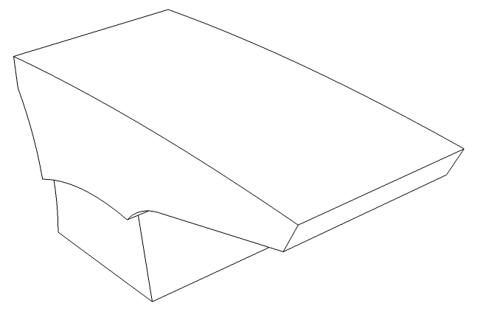

Slide 11
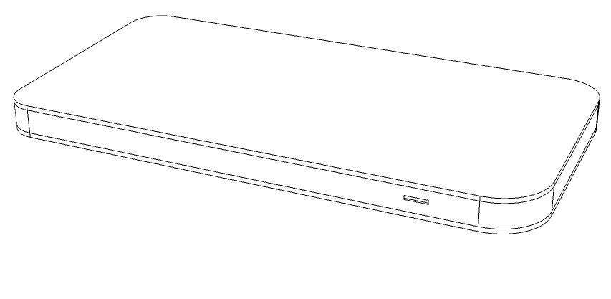

Slide 13
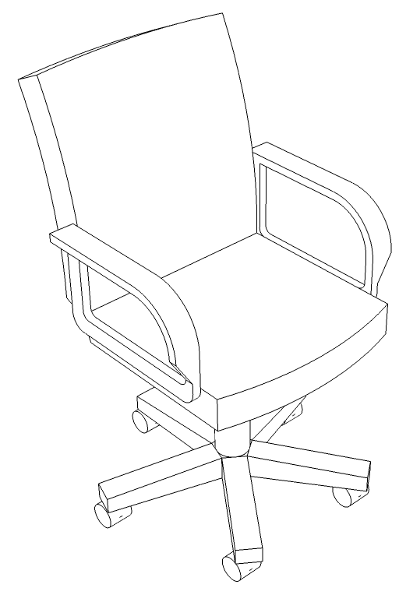

Slide 14
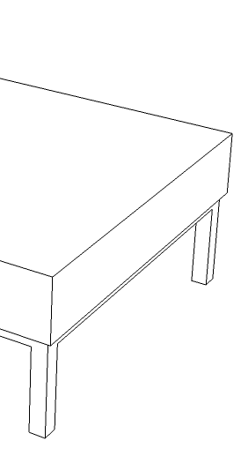
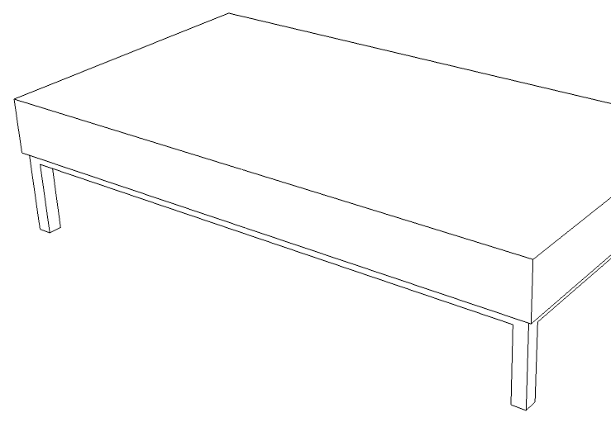

Slide 17
if arm found
Determine Arm Presence
Finger tracking
Gesture recognition
if arm not found

Slide 18
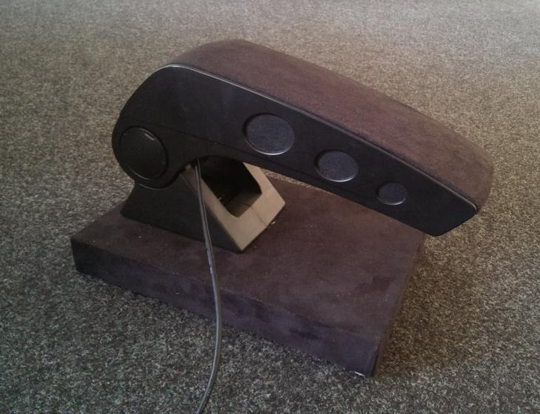
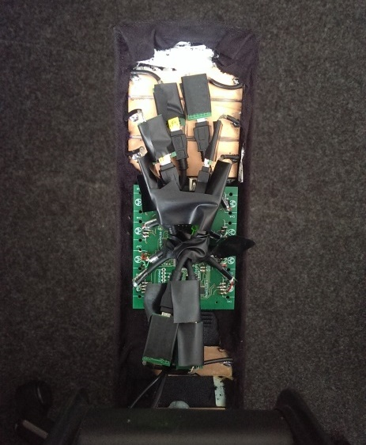
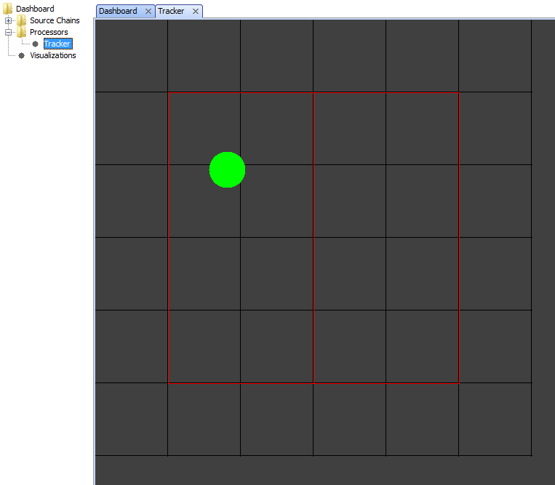
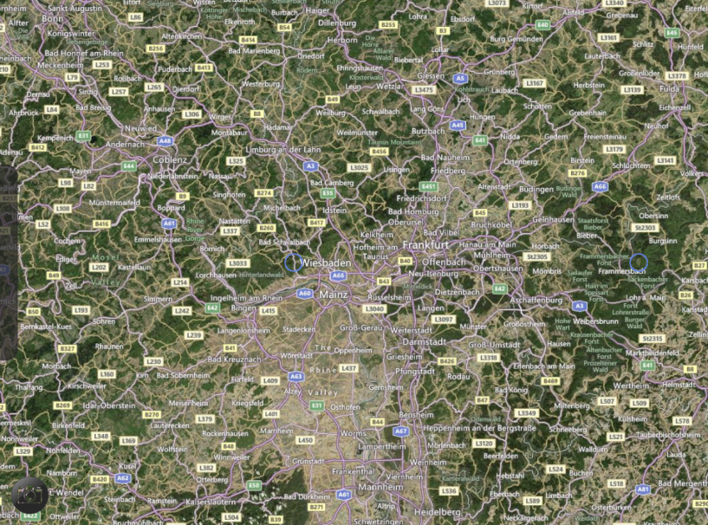

Slide 19
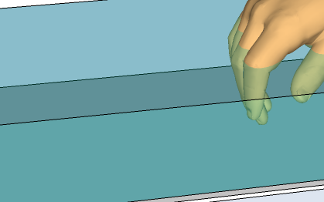
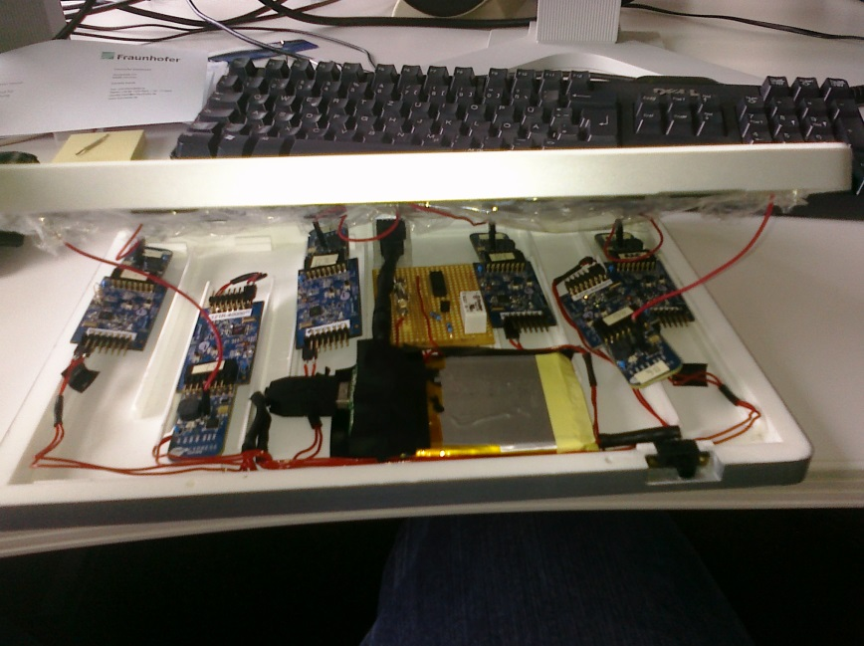
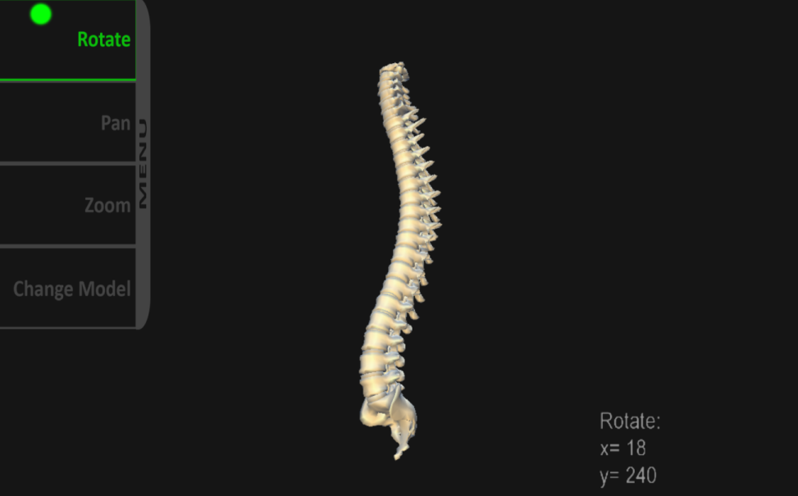
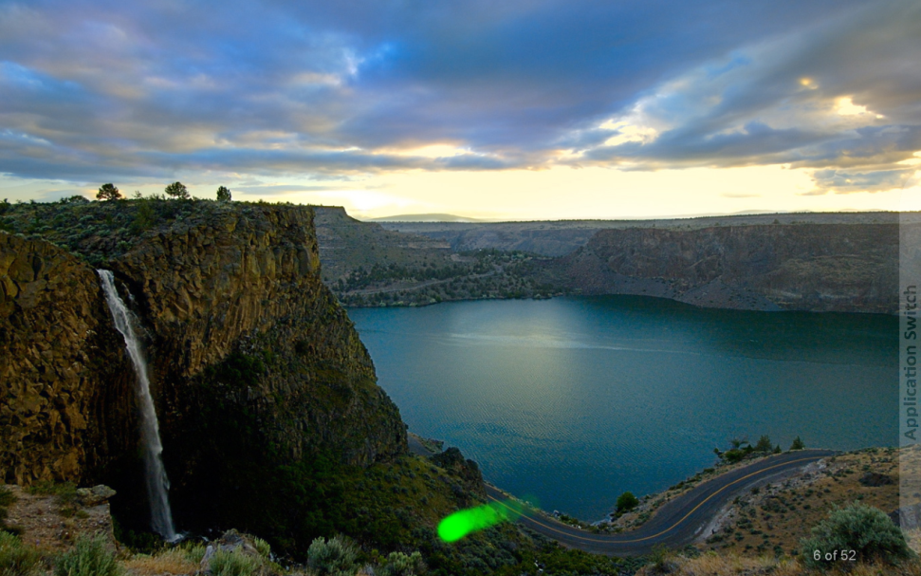

Slide 20
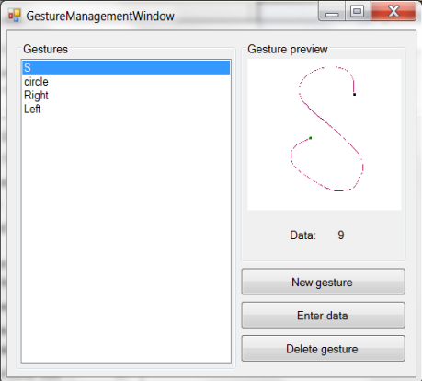
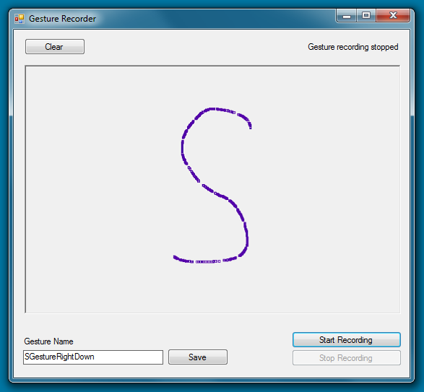
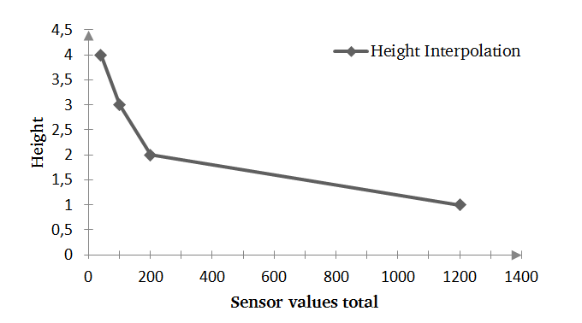

Slide 21
α
α

Slide 23
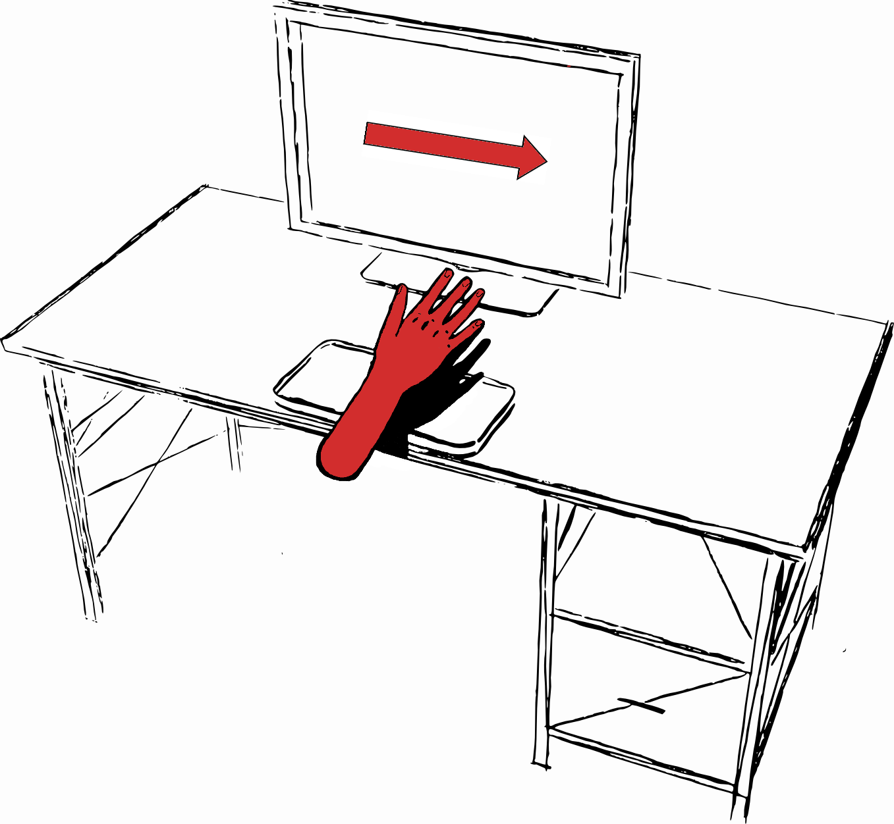

Slide 24
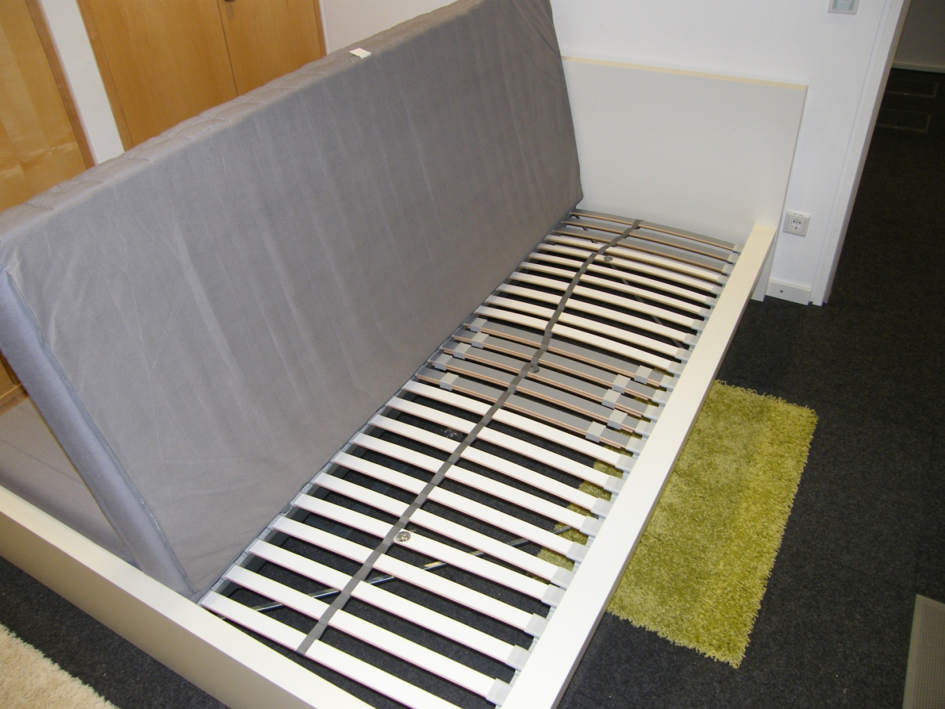
Electrodes

Slide 25
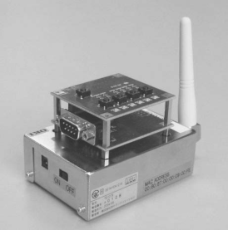
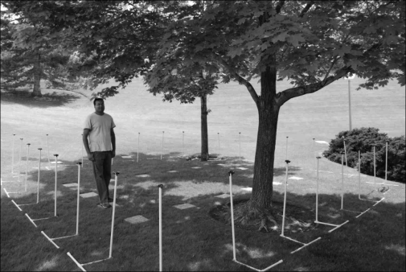
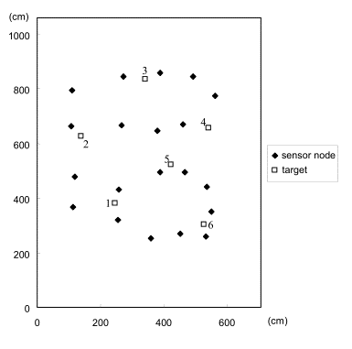
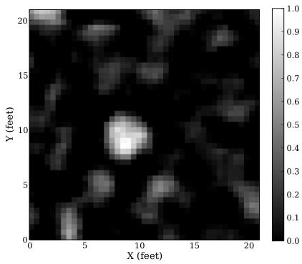

Slide 26
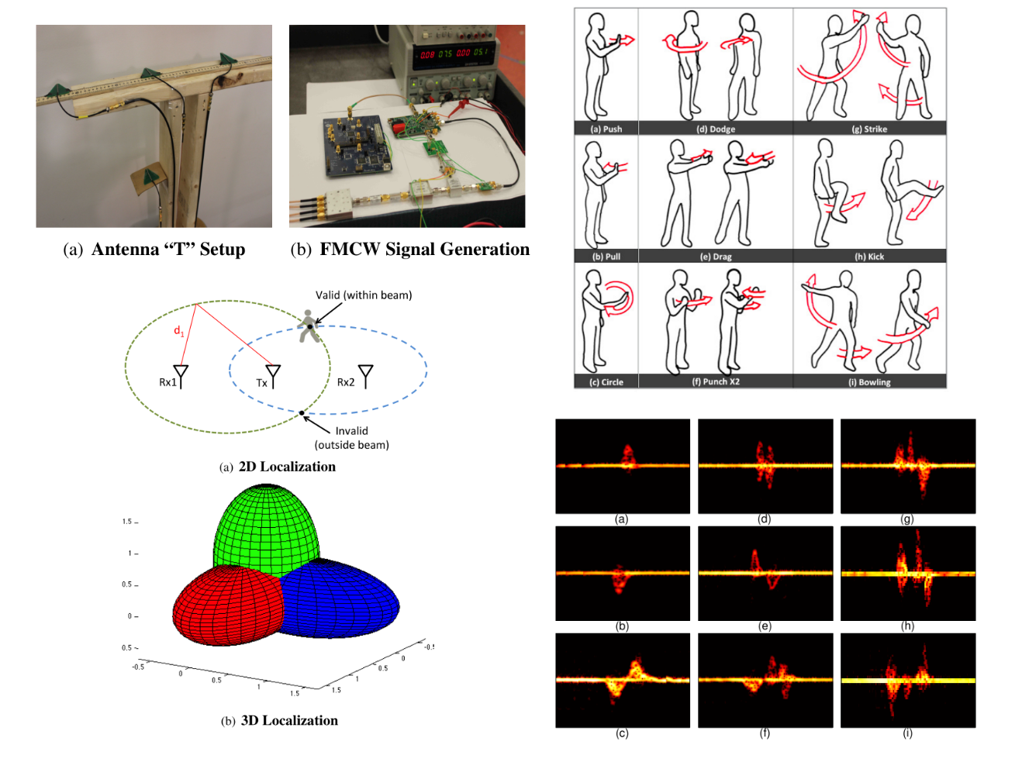

Slide 27
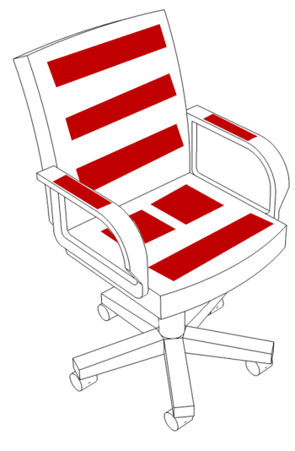
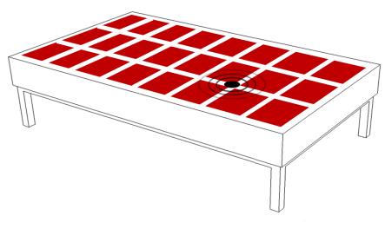
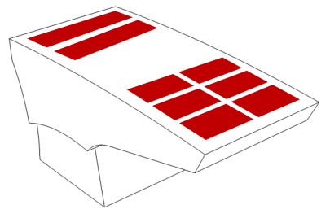
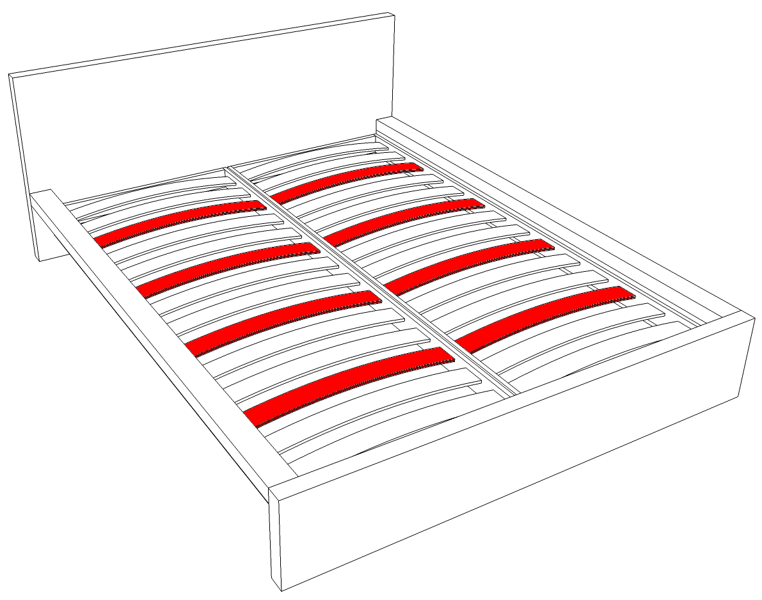
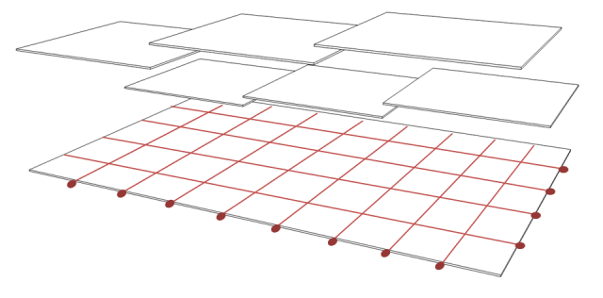
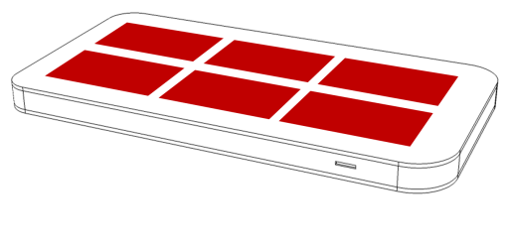

Slide 28
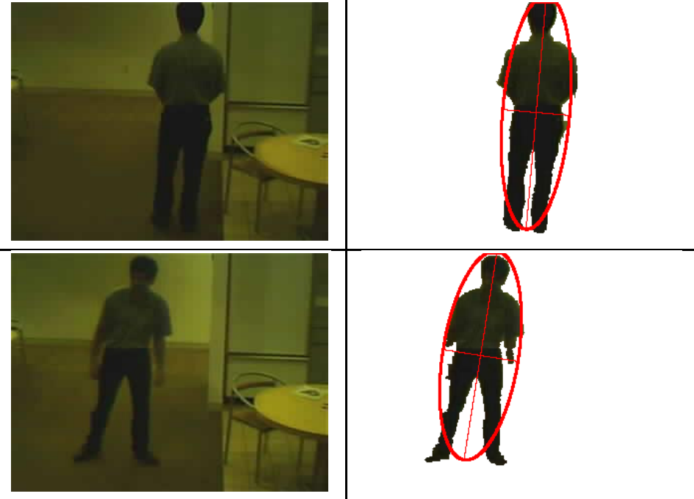
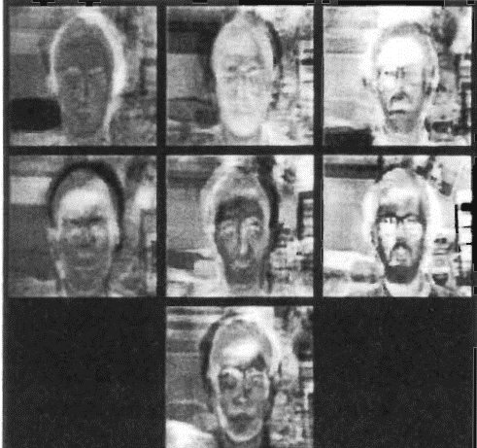

Slide 29
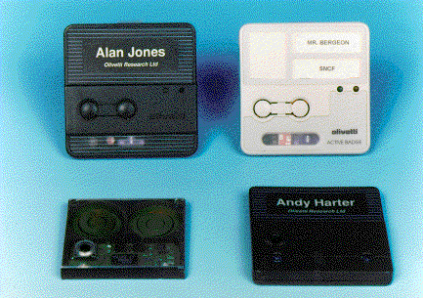
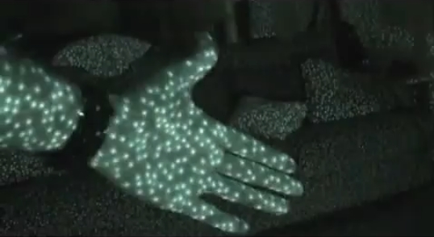
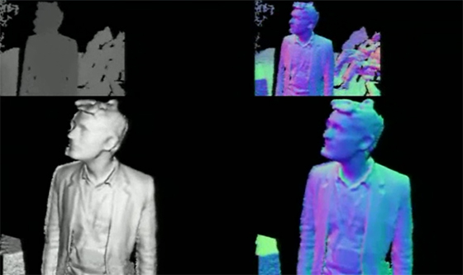
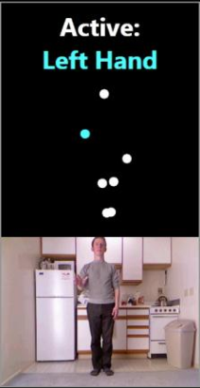
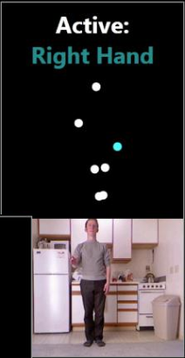

Slide 30
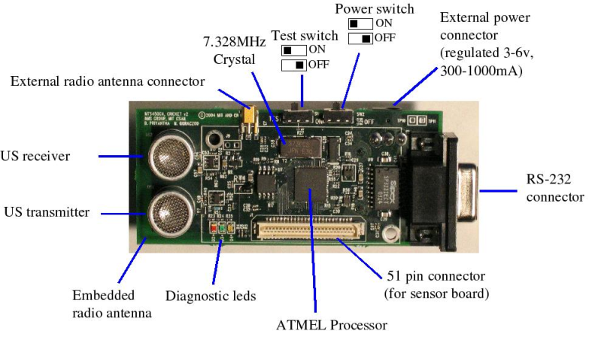
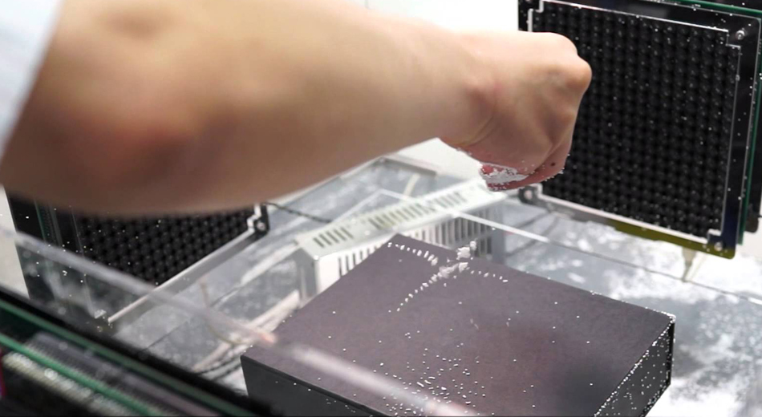
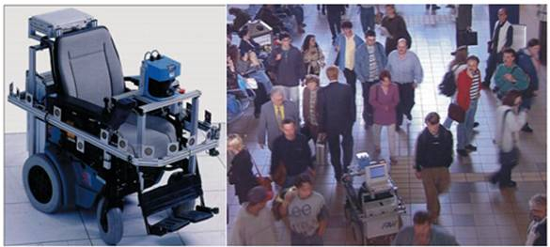
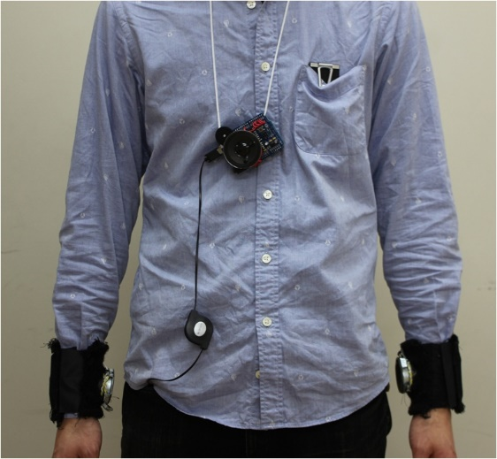

Slide 31
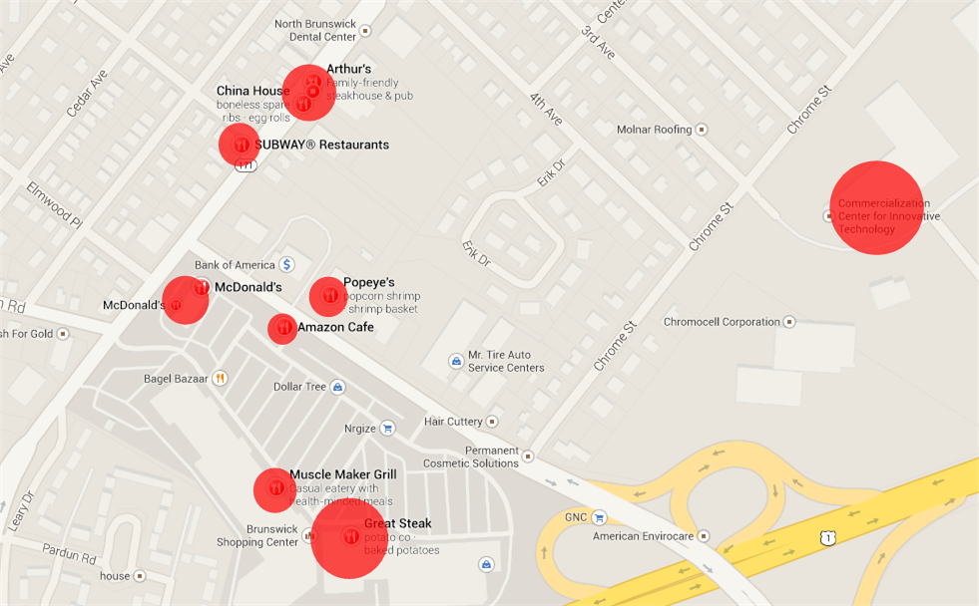



Slide 32



Slide 33






Slide 34




Slide 35



Slide 36




Slide 37





Slide 38






Slide 39




Slide 40





[Img3]

Slide 41





Slide 42


Slide 43





Slide 44





Slide 45


1
2
3
4
5
6
7
8

Slide 46


Slide 48




Slide 49





Slide 50






Slide 51



Slide 52




Slide 54
Limb Electrodes Finger Array

Slide 55
Body
Mattress
Flexible Electrode

Slide 56





Slide 57
Electrode
Airflow
Chest movement
Breathing In
Breathing Out

Slide 58
Placeholder

Slide 59
Tabletop
Sensing Electrode
5 cm

Slide 60
Sensor choice
Hardware design
Algorithms
Measured property
Suitable technologies
Benefits of capacitive technology
Number of sensors
Sensor geometry
Electrode material
Pre-processing methods
High-level methods

Slide 61


Slide 62


Slide 63

Head
Torso
Left upper arm
Low back
Left lower arm
Left upper leg
Left knee
Left lower leg
Right upper arm
Mid back
Right lower arm
Pelvis
Right upper leg
Right knee
Right lower leg

Slide 64





Slide 65







Slide 66



Slide 67



Slide 68


Slide 69


